Slide 1
Supporting with the Cost of Living What frontline professionals need to know
Kristy Thakur Head of Community & People Wellbeing, Hertfordshire County Council
Benjamin Negus HertsHelp Contract Manager, HertsHelp
Mark Hanna CEO, Age UK Hertfordshire
Gary Vaux Head of Money Advice Unit, Hertfordshire County Council
Charlotte Blizzard-Welch Partnership & Development Manager, Citizens Advice Hertfordshire
Miriam Blom-Smith and Asha McDonagh
Research Officers
Healthwatch Hertfordshire
Notes:
Kristy intro slide
Advise that the webinar is being recorded
Why are they here
Set context
What are the outcomes
COVER that staff are people too and can access support
Q&A explainer
Set up COL email

Slide 2
Welcome – Why we are here
Improve interactions with residents
Inform of support available
Create connections
Improve confidence when interacting with residents
Notes:
Lucy or Mark

Slide 3
Cost of Living Survey
January insights
As of 6th January, 4470 responses:
70% of respondents say the Cost of Living is affecting them a little bit, but they’re managing
23% say the Cost of Living is affecting them a lot, and they’re struggling
38% either have just enough for basic necessities, or not enough and sometimes run out
---
80% are using less heating or reduced other energy bills (also the most concern)
62% going out less
59% are buying cheaper or lower quality food
NB: 42% of respondents so far have been aged 65+, and 81% were White British

Slide 4
Cost of Living Survey
January insights
Health:
Avoiding dentist and optician visits are most common healthcare affected:
“My teeth are dead and I'm in constant pain but can’t afford the treatment”
9% have spent less on prescriptions/medication; skipping doses or stopping medication
“I need vitamins and meds for a crippling condition but can’t afford it”
55% say their mental health is being affected
“It seems a bleak future”; “not going out”; “not able to eat properly”
31% say their physical health is being affected, many people saying from living in cold and damp homes

Slide 5
Cost of Living Survey
January insights
Awareness and use of services:
3% have used warm hubs, but 16% unaware of them (82% aware but haven’t used)
5% have used food banks, but 5% unaware of them (90% aware but haven’t used)

Slide 6
The cost of living – update for 2023
No repeat of the universal Energy Bills Discount Scheme after the March 2023 payment
Jan 2022, energy price guarantee was £1,227; it rose to £1,971 in April 2022 and £2500 in October 2022
Cap rises to £3,000 for average households in April – but if you use more, you pay more.
Notes:
Gary
Impact of Russia/Ukraine war

Slide 7
Inflation
Benefits rose by 3.1% in April 2022, based on inflation in September 2021
October 2022 inflation rate is 11.1% but September rate of 10.1% to be used as basis for April 2023 benefits increase.
“Low-income inflation rate” is much higher – around 14% as more of income spent on basics (food and fuel), which have increased most.
Notes:
Gary
Impact of Russia/Ukraine war

Slide 8
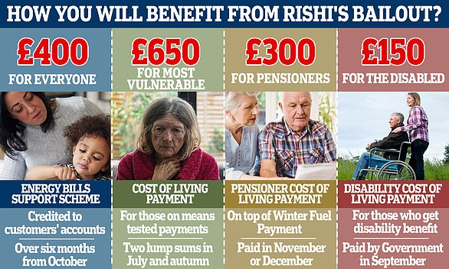
April 2022 – 2023
Cost of Living Support
from DWP
Report a missing £650/£150 Cost of Living Payment
If the £300 Pensioner payment has not been paid by 13 January 2023, contact the Winter Fuel Payment Centre.

Slide 9
April 2023 onwards
The £900 payment for people on means-tested benefits will go direct to bank accounts in three payment. There will also be a separate £150 for disabled people (including children) getting DLA, PIP or Attendance Allowance, and £300 for all pensioners on top of their usual £200 Winter Fuel Payments.
Spring 2023
First Cost of Living Payment
£301
Summer 2023
Disability Payment
£150
Autumn 2023
Second Cost of Living Payment
£300
Winter 2023
4
Pensioner Payment
£300
Spring 2024
Third Cost of Living Payment
£299

Slide 10
The April 2023 changes
National Living Wage going up (23+) from £9.50 an hour to £10.42 per hour
However, tax and National Insurance can mean 32% is lost; and if on universal credit a further 55%
People still on income-related ESA will not be moved to universal credit until 2028
Notes:
Gary

Slide 11
Free School Meals and Pension Credits
Pension Credit: Eligibility - GOV.UK (www.gov.uk)
Apply for free school meals - GOV.UK (www.gov.uk)
Notes:
kristy
Previously HCC £6.2 million with 1/3 spending on families with children and 1/3 on low income pensioners
£6.1m in Hertfordshire for County Council to spend from DWP
One-third has to be spent on pensioners (£2m) by end of March 2023
Payments towards costs of food, energy and water bills - £150 to all on pension credit already

Slide 12
Warm Spaces
Heating our homes is more expensive than ever, so HCC have worked with our partners to develop a network of Warm Spaces, which people can use to stay warm this winter. The online directory will let people find libraries, family centres and community spaces near them where they can stay safe and warm. Click here to find a Warm Space local to you.
Warm Herts Fund - Warm Spaces grants to enable groups to open their doors wide this winter. Warm Herts Fund (hertscf.org.uk)
Notes:
Kristy
Previously HCC £6.2 million with 1/3 spending on families with children and 1/3 on low income pensioners

Slide 13
What help is out there in Hertfordshire?
0800 144 8848
0300 345 3446
0300 123 4044
www.Hertfordshire.gov.uk/benefits
Notes:
Kristy

Slide 14
Age UK Hertfordshire Information & Advice Service Increased Demand
37, 146 enquiries from older people in 2021-22 – already at 29,574 so far this year
£78,000 in food & energy vouchers distributed since April 2022
In the last 3 months, we have seen:
300% increase in enquiries about accessing food banks
93% increase in enquiries about accessing benefits
850% increase in enquiries about help with heating bills and concerns over difficulties paying bills
Notes:
Mark

Slide 15
Age UK Hertfordshire
How our Information & Advice Team can help:
Help you explore your rights, entitlements or access to benefits, concessions and grants
Provide practical support to help complete the application forms via phone and face to face
Provide information to help you remain independent in your own home and how to help with heating costs
Support to access online services safely and to be more digitally included
Raising awareness of Scams and supporting those who have been Scam victims
Email: info@ageukherts.org.uk Telephone: 0300 345 3446
Notes:
Mark

Slide 16
How Age UK Hertfordshire helped Bob and Rita
Notes:
Mark Bob and Rita, both age 76, were referred to Age UK by the Paramedic Community Respiratory Team due to Bob’s health.
Only income was State pension, small private pension, middle rate of DLA (Care), a small amount of housing benefit and council tax support. Costs were rising due to inflation and Bob’s poor health
Age UK helped Rita claim Carers Allowance (she had underlying entitlement to it). This led to extra housing benefit and council tax support. They also got pension credit – a total gain of £130 pw.
They also got a free tv licence (£159 pa), a Warm Homes Discount (£150 pa), plus £650 cost of living payment (2022) and a £900 one in 2023, plus help with NHS costs.

Slide 17
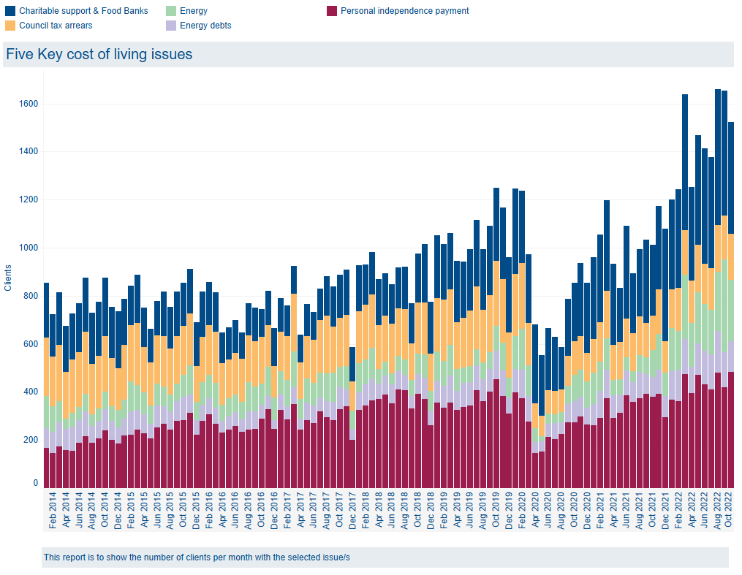
Citizens Advice Hertfordshire
Citizens Advice Hertfordshire is experiencing record-breaking demand for our services as people grapple with the cost-of-living crisis.
The crisis is also unprecedented in a longer view. This chart shows the trend for some of our key cost of living issues over the past decade, based on the number of people we helped with these issues each month.
August 2022 was highest month on record.
Notes:
Charlotte

Slide 18
Citizens Advice Hertfordshire
Services available throughout Hertfordshire Crisis Intervention Advice Team Cost of Living Advisers
Out of hours Adviceline (coming December 2022)
HERT Debt Advice in partnership with the Money Advice Unit
Universal Credit Support
Welfare Benefit Appeals Support
Pension Wise
Employment Advice and Representation
Advice via British Sign Language
We provide free, confidential and impartial advice. Our goal is to help everyone find a way forward, whatever problem they face.
People come to us with all sorts of issues. They may have money, benefit, housing or employment problems. They may be facing a crisis, or just considering their options.
Notes:
Charlotte

Slide 19
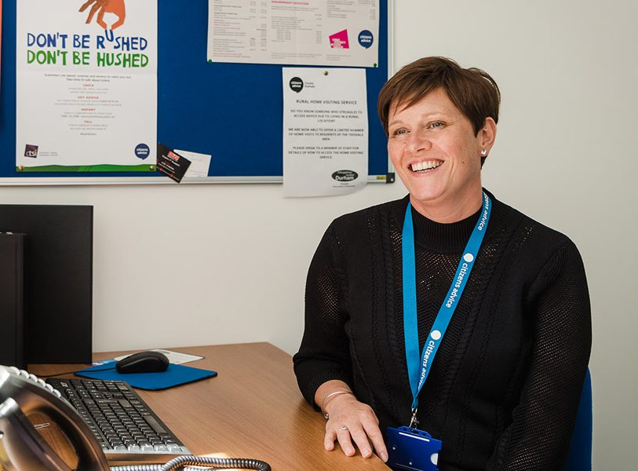
How Citizens Advice Hertfordshire helped Claire
Notes:
Charlotte to insert HCNS referred c/s

Slide 20
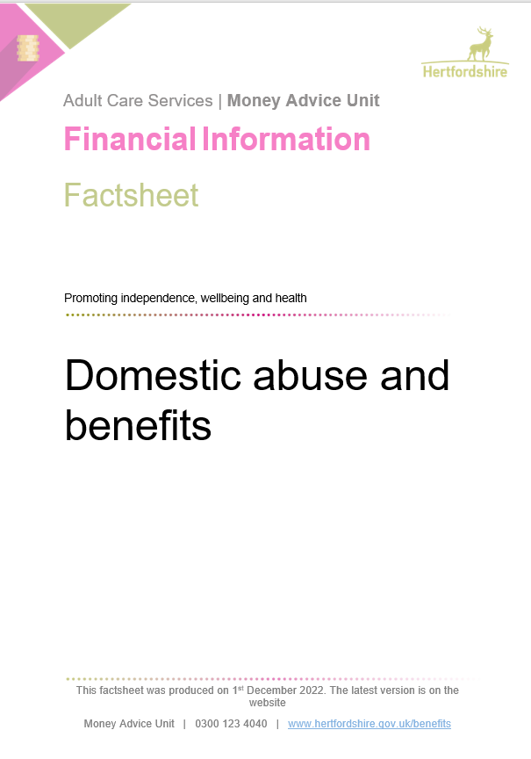
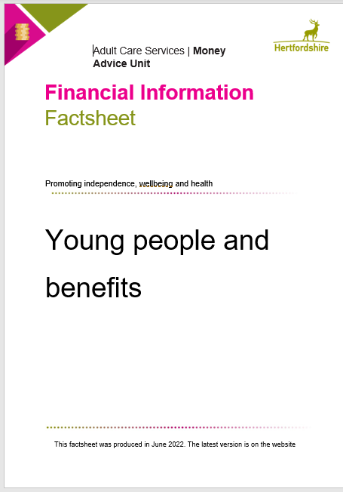
Money Advice Unit
Not a public service like Citizens Advice or Age UK but we do provide targeted project-based casework e.g. children with disabilities; people affected by cancer; referred by HPFT; families in crisis etc. In 2021, assisted over 4300 households and raised almost £19m in extra benefits.
Huge training programme on all benefits and client groups; outreach work and talks with groups such as Family Centres, foster carers, older peoples groups, care providers, community groups and housing associations eht etc
MAU – 01438 843456 (office)
moneyadvice.unit@Hertfordshire.gov.uk
www.hertfordshire.gov.uk/benefits
Notes:
Gary

Slide 21
MAU – 2021/22
4391 households supported - £18.7m additional benefits gained from cases closed in the year.
360 referrals a month
MAU 2022/23
3477 referrals so far – 425 a month. Projected gain £20m from cases closed in year
MAU - - provides factsheets, adviceline, training, policy advice and briefings, supports stakeholders and engages in cross-Departmental work – e.g. covid and cost of living response

Slide 22
How the Money
Advice Unit
helped
Rashmi
Notes:
Charlotte to insert HCNS referred c/s

Slide 23
We offer the following services:
help finding childcare
antenatal classes
support with breastfeeding
health visiting (0-5 years)
school nursing (5 years+)
support with parenting and speech and language
services for children with special needs and disabilities
support for families experiencing domestic abuse
opportunities for families to get involved with volunteering
and much more! Check out about the Family Centres page

Slide 24
Children receiving FREE SCHOOL MEALS in Herts can also access 1000’s of FREE school holiday camps & activities through the HAPpy: Holiday Activity Programme.
Every day includes fun activities and a hot meal for each child.
The programme provides respite, enables many parents to continue working through the school holidays and gives children valuable social and community engagement.
Booking codes are shared via all schools in Herts.
HAPpy Activity Camps - Herts Sports Partnership (sportinherts.org.uk)
Enquiries: haf@herts.ac.uk
Notes:
kristy
Previously HCC £6.2 million with 1/3 spending on families with children and 1/3 on low income pensioners
£6.1m in Hertfordshire for County Council to spend from DWP
One-third has to be spent on pensioners (£2m) by end of March 2023
Payments towards costs of food, energy and water bills - £150 to all on pension credit already

Slide 25
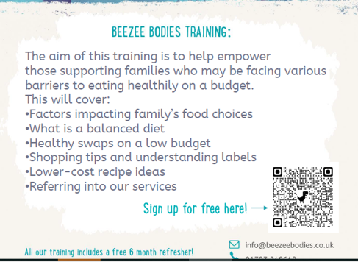
Healthy Lifestyle training
Notes:
Ben

Slide 26
Hertfordshire single access point for support through HertsHelp
HertsHelp – single point of access to community and financial support / advice
HertsHelp wellbeing offer is a ‘non judgmental’ way to signpost support available
‘If you don’t know where to go for support, go here: HertsHelp’…‘There is always someone who can help’
HertsHelp Crisis Intervention Service: One-off financial support to those on the point of crisis, such as food and fuel support
Referral to Community Navigation Service
Contact via 0300 123 4044 or email info@hertshelp.net
Open Monday - Friday (8am - 6pm) and Saturday – Sunday (10am – 4pm).
Notes:
Ben

Slide 27
Partner activity
Broxbourne: Help to manage the cost of living – Borough of Broxbourne Council
Dacorum: Cost of living (dacorum.gov.uk)
East Herts: Help to manage the cost of living | East Herts District Council
Hertsmere: All Financial Support - Hertsmere Borough Council
North Herts: Help with the cost of living | North Herts Council (north-herts.gov.uk)
St Albans: Cost of living support | St Albans City and District Council
Stevenage: Help to manage the cost of living (stevenage.gov.uk)
Three Rivers: Help for people with money problems (threerivers.gov.uk)
Watford: Cost of living support – www.watford.gov.uk
Welwyn Hatfield: Help with the cost of living – Welwyn Hatfield Borough Council (welhat.gov.uk)
Notes:
Ben
ICS – Funded projects
Districts costs of living websites
Add logos and blurb
How FRLN workers can play their part and support

Slide 28
“Here for you this winter”
Campaign website www.hertfordshire.gov.uk/hereforyou Communications toolkit www.hertfordshire.gov.uk/hereforyoutoolkit Winter health booklet www.hertfordshire.gov.uk/winterwellbeing
Notes:
Ben
Previously HCC £6.2 million with 1/3 spending on families with children and 1/3 on low income pensioners

Slide 29
If you have any further questions, please contact VPA.Cell@hertfordshire.gov.uk
Notes:
Ben

