Slide 1









[GP NAME]
[PRACTICE NAME AND ADDRESS]
TODAYS DATE 10th October 2016
Dear ………..
As someone with a learning disability, you may be more at risk of complications if you get the flu.
We are inviting you to have a free injection to protect you against the flu. If you are someone who refuses to have injections it can be given by a spray in your nose instead
Please come to your GP surgery on
Date
Time
Address

Slide 2







GP Number
If you cant come on this day please ring your GP surgery.
The receptionist will help you to make an appointment for another day or time.
Please have a look at the leaflet about the flu injection with someone who helps you.
This will help you understand why we think it is important that you have this injection.
If you don’t understand then your carers and family can help the doctor to decide for you.
If you do understand what is good and bad about this injection, then you can decide for yourself whether you want to have it or not.
If you decide you don’t want it then please ring your GP surgery to talk to someone about it.

Slide 3


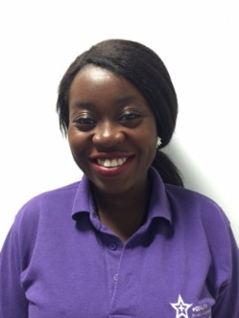
If you have a carer they can also have a free flu injection which will help protect them and the people they care for against flu. They will need to contact their own GP to arrange this.
Thank you and we look forward to seeing you.
GP PRACTICE DETAILS]
You can also call the learning disability link nurse for your doctors surgery if you would like more help.
LINK NURSE NAME AND CONTACT DETAILS
Go to www.hertfordshire.gov.uk/ldmyhealth for easyread information and a capacity to refuse / consent tool
Template adapted from https://www.gov.uk/government/publications/flu-vaccination-easy-read-invitation-letter-template
Photos from www.photosymbols.com

